Slide 1

Implementer’s Lessons Learned
Intermountain Healthcare
HIEA, August 17, 2016 Rosslyn VA
Stanley M. Huff, MD

Slide 2
Why?
“To help people live the healthiest lives possible.”
4

Slide 3
Patient
3

Slide 4
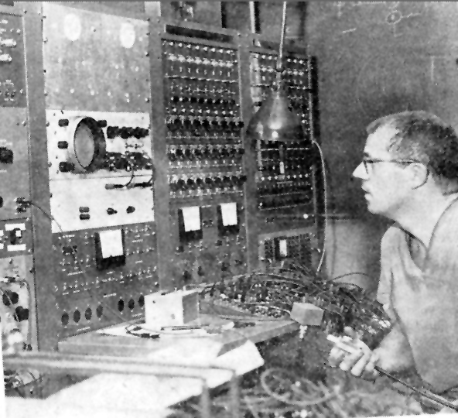
Homer Warner and HELP
Intermountain can only provide the highest quality, lowest cost health care with the use of advanced clinical decision support systems integrated into frontline clinical workflow
Dr. Homer Warner
Notes:
4

Slide 5
Core Assumptions
‘The complexity of modern medicine exceeds the inherent limitations of the unaided human mind.’
~ David M. Eddy, MD, Ph.D.
‘... man is not perfectible. There are limits to man’s capabilities as an information processor that assure the occurrence of random errors in his activities.’
~ Clement J. McDonald, MD
5

Slide 6
Need for coded data
Tom East’s experience with “Oral meds”
Oral, ORAL, Oral, ORALLY, Orally, ORALY, OR, or, PO, P.O., P.O, PO., po, per os, by mouth, … (26 variants)
Observation #1: You can not anticipate all of the ways that information can be recorded in free text.
Observation #2: You can not reliably execute real time decision logic against free text data
Conclusion #1: You need coded or “computable” data
9

Slide 7
Challenges to consistent data
7

Slide 8
PTXT for Serum Creatinine
13 1 1 0 0 0 0 7 Channel
13 1 1 1 7 0 0 Creatinine (mg/dL)
13 1 4 0 0 0 0 20 Channel
13 1 4 1 13 0 0 Creatinine
13 1 14 0 0 0 0 Creatinine Clearance
13 1 14 1 9 0 0 Creatinine
13 1 85 0 0 0 0 Amylase/Creat Ratio
13 1 85 1 3 0 0 Creatinine
11

Slide 9
PTXT for Heart Rate
2 1 17 5 0 0 0 4 Heart Rate === BPM
3 0 3 0 5 5 0 16 Heart Rate (NOVA)
7 1 1 1 1 0 0 0 Heart Rate
28 1 60 2 14 15 0 0 Supine HR: ===
28 1 60 2 14 30 0 0 Tilt HR ===
32 1 22 1 4 0 0 0 Heart Rate ====
4 0 1 0 1 1 0 16 HR Manual (CCU)
4 0 5 0 4 4 0 16 Thermodilution HR
4 0 32 0 24 10 14 1 HR CCU Monitor
12

Slide 10
Evolution of models at Intermountain
PTXT – Pointer To Text (~1968)
Abstract Syntax Notation 1 (ASN.1) (1992)
~1,500 models
XML (didn’t work)
Clinical Element Modeling Language (2005)
~7,000 models
Clinical Information Modeling Initiative (CIMI) (2011)
Currently ~2,500 lab data models, and growing
13

Slide 11
What if we use different models?
Site #1
70
Dry Weight:
70
kg
Site #2
70
Dry
Weight:
70
kg
Wet
Ideal

Slide 12
Too many ways to say the same thing
A single name/code and value
Dry Weight is 70 kg
Combination of two names/codes and values
Weight is 70 kg
Weight type is dry

Slide 13
Implications of different models
Patient Identifier
Date and Time
Observation Type
Observation Value
Units
123456789
7/4/2005
Dry Weight
70
kg
123456789
7/19/2005
Current Weight
73
kg
Patient Identifier
Date and Time
Observation Type
Weight type
Observation Value
Units
123456789
7/4/2005
Weight
Dry
70
kg
123456789
7/19/2005
Weight
Current
73
kg
How would you calculate the desired weight loss during the hospital stay?

Slide 14
The danger
No true interoperability because
Vendors use different models/profiles
Government agencies use different models/profiles
Provider organizations use different models/profiles
Professional organizations use different models/profiles

Slide 15
Questions?
15

Slide 16
Appendix
16

Slide 17
A data driven culture
17

Slide 18
Value Cycle
Clinical
Financial
Data Integration
Claims
Decision Support
Improved Care
Ideas
Research
Pt. Satisf
Device
& More
Patient
Care
Data
EDW
Insight
Action
Notes:
- Our patient care experience gives us a lot of data
- The data gives us an opportunity to take ideas and apply rigorous research
- Research validates the ideas, which are then applied with confidence to improve patient care
- This helps us make better decisions…not just in the future, but starting today
- The EDW is key in spinning this cycle faster to gain the insight necessary to decisively act, so we can improve the quality of care for our patients

Slide 19
Patient Care and Analytics
Real time decision support and population analytics both benefit greatly from coded and structured data
Real time decision support must be as accurate as possible
Population analytics only have to be as accurate as needed to answer a quesiton
16

Slide 20

EDW Conceptual Architecture
Enterprise Data Warehouse
Data Sources
Data Access
Internal
Finance
Lab
EMR
Cardiovascular
Claims
Patient Acct
Primary Care
Pharmacy
Claims
SUBJECT Data Marts
SOURCE Data Marts
EMR
Women
& Newborn
Supply Chain
BI Tools
OTHERS
AHR
Patient Sat.
External
Surgical Serv
State/Federal
Master Reference Data
Notes:
Systems Supplying the EDW
Clinical
Radiology, Pharmacy, Laboratory, HELP1, ORMIS, HELP2, others
Financial
Hospital Case Mix, Supply Chain, Accounts Receivable, Materials Management
Patient Satisfaction
Health Plans Claims
HR and Payroll
State of Utah
Enterprise Master Patient Index
Many More
Master Reference Data
Review our strategy to standardize a core set of critical data elements in order to facilitate easy linking of disparate data sources.
Mention that is only a sample and refer them to the EDW website for a full listing and description of the core elements.
Review our strategy to standardize a core set of critical data elements in order to facilitate easy linking of disparate data sources.
Mention that is only a sample and refer them to the EDW website for a full listing and description of the core elements.
Patient Member ID
Clinical Program ID
Facility ID
Employee ID
Provider ID
Payer/Carrier ID
Department ID
Region ID
Postal Code
CPT Code
DRG Codes
ICD9 Procedure Code
ICD9 Diagnosis Code
Charge Code
Patient Type Code
National Drug Code
Others

Slide 21
The start of a Learning Healthcare System is accurate, computable, data.
18

Slide 22
What is “true” interoperability?
22

Slide 23
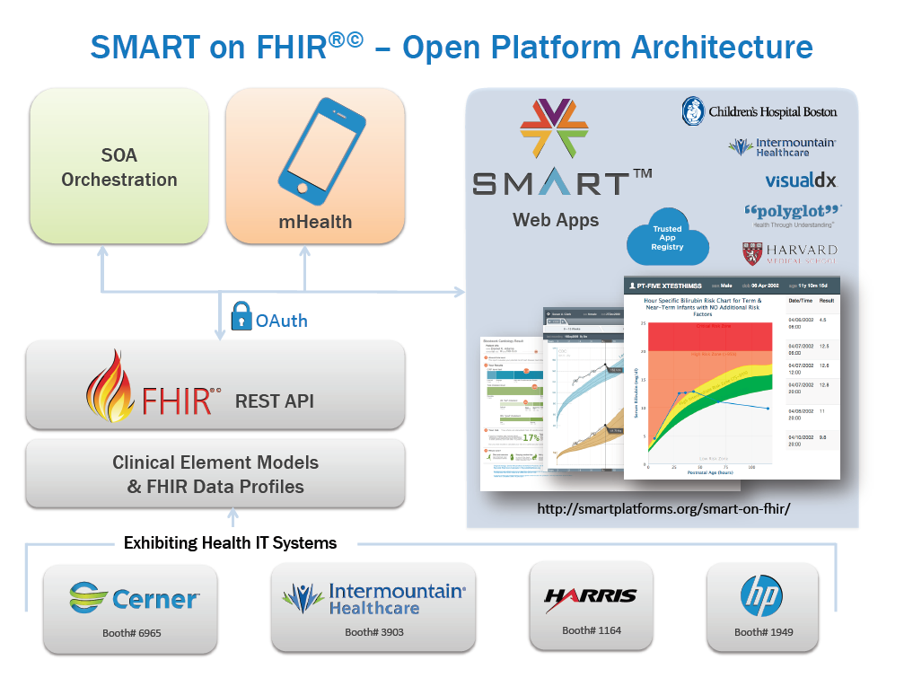
FHIR Profiles from CIMI Models
(using standard terminology)
Heterogeneous Systems
23

Slide 24
“True Interoperability”
Data shared through standard messages
Data accessed via standard services
The data has a standard logical structure
Standard information models
Standard terminology
Sharing of applications, data, information, and knowledge
21

Slide 25
The Value of “Truly” Interoperable Systems
25

Slide 26
Current Situation
Each EHR vendor uses a proprietary database schema, proprietary models and unique terminology to represent clinical data
Some standardization of codes is now occurring, but
Data is not consistent vendor to vendor, or even organization to organization within the same vendor
This means that:
Sharing data is difficult
Sharing executable software across vendors is impossible
Each useful application is created or re-created on each different platform
23

Slide 27
The Future Ecosystem
Standards are defined that enable “truly” interoperable systems using standards based services and an SOA Platform for orchestration and integration
Old and new EHR vendors:
Support standards based services (HL7 FHIR®©)
Support SMART® applications
Thousands of people develop software that runs on truly interoperable platforms
Open source, academics, and for-profit developers
Apps, including clinical decision support algorithms, are for sale in a vendor neutral marketplace
Apps can be certified as HSPC compliant
Platform vendors certify apps as safe for use in their platform
24

Slide 28
The Future Ecosystem (2)
People buy a patient data platform
Includes auditing, security, authorization, patient selection, etc.
May include some core apps: order entry, results review, notification, etc.
People buy the apps they need
There is also a marketplace for sharing knowledge, especially protocols, workflows, order sets, ontologies, etc.
Patients receive better care at a lower cost because lower cost higher quality apps are available as driven by market forces
25

Slide 29
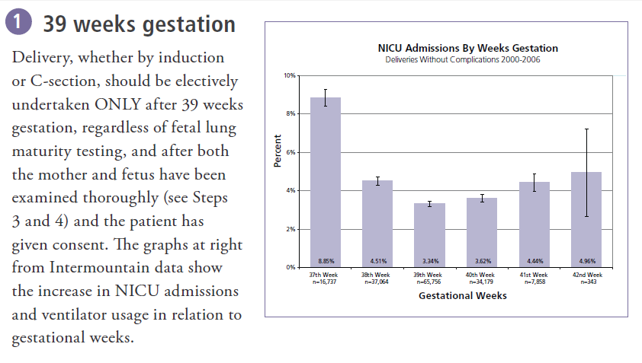
NICU Admissions
29

Slide 30
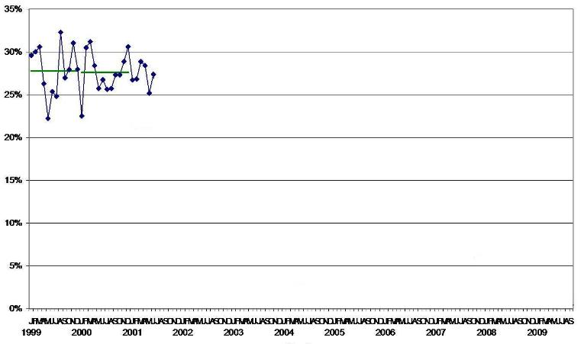
Elective Labor Induction <39 Weeks
Percent <39 Weeks
30
Notes:
Elective inductions can be convenient for doctors and expectant families and can spare mothers some of the discomfort of the final weeks of pregnancy. But since 1999, the American College of Obstetricians and Gynecologists has recommended that, for the sake of the baby’s health, no elective inductions be done before the 39th week of pregnancy. The dating of pregnancy is sufficiently uncertain that what is thought to be the 38th week may really be the 36th week, and a baby born in the 36th week is more likely to have underdeveloped lungs or other problems. Early elective inductions also lead to longer labors and more C-sections.
Despite the recommendation, though, about 30 percent of elective inductions at Intermountain in 2001 were done before 39 weeks, roughly what the national share was. That year Intermountain adopted a protocol urging doctors to avoid most early inductions, and only then did the rate begin to fall. One hospital in southwest Utah has gone so far as to allow nurses to refuse a doctor’s early-induction orders unless the medical director has given permission. By 2004, the share of elective inductions done before the 39th week at Intermountain fell to 5 percent, and it is now less than 2 percent. The number of newborns with respiratory problems has also dropped.

Slide 31
Elective Delivers <39 Weeks
Percent <39 Weeks
31
Notes:
Elective inductions can be convenient for doctors and expectant families and can spare mothers some of the discomfort of the final weeks of pregnancy. But since 1999, the American College of Obstetricians and Gynecologists has recommended that, for the sake of the baby’s health, no elective inductions be done before the 39th week of pregnancy. The dating of pregnancy is sufficiently uncertain that what is thought to be the 38th week may really be the 36th week, and a baby born in the 36th week is more likely to have underdeveloped lungs or other problems. Early elective inductions also lead to longer labors and more C-sections.
Despite the recommendation, though, about 30 percent of elective inductions at Intermountain in 2001 were done before 39 weeks, roughly what the national share was. That year Intermountain adopted a protocol urging doctors to avoid most early inductions, and only then did the rate begin to fall. One hospital in southwest Utah has gone so far as to allow nurses to refuse a doctor’s early-induction orders unless the medical director has given permission. By 2004, the share of elective inductions done before the 39th week at Intermountain fell to 5 percent, and it is now less than 2 percent. The number of newborns with respiratory problems has also dropped.

Slide 32
Decision Support Modules
Antibiotic Assistant
Ventilator weaning
ARDS protocols
Nosocomial infection monitoring
MRSA monitoring and control
Prevention of Deep Venous Thrombosis
Infectious disease reporting to public health
Diabetic care
Pre-op antibiotics
ICU glucose protocols
Ventilator disconnect
Infusion pump errors
Lab alerts
Blood ordering
Order sets
Patient worksheets
Post MI discharge meds

Slide 33
We can’t keep up!
We have ~150 decision support rules or modules
We have picked the low hanging fruit
There is a need to have 5,000+ decision support rules or modules
There is no path from 150 to get to 5,000 unless we fundamentally change the ecosystem
33

Slide 34
Apps that enable data sharing…
App 1
Next-gen Interoperability
Population Health integration
HIE integration
Data capture for research
Clinical Trial recruiting
EHR
1
EHR
2
EHR
3
31

Slide 35

The cost of medical software
Becker’s Health IT & CIO Review
Partners HealthCare: $1.2 billion Boston-based Partners HealthCare is one of more recent implementations, going live the first week of June to the tune of $1.2 billion. This is the health system's biggest investment to date. The implementation process took approximately three years, and in that time, the initial price tag of $600 million doubled.
Intermountain Medical Center $550 million
35

Slide 36
(from Research America)
33

Slide 37
The start of a Learning Healthcare System is accurate, computable, data.
34

Slide 38
More Reasons
Agile software development
Widely distributed
Directed daily by front line clinicians
Increased usability of software, creativity, innovation
Increased choice in software
Thousands of independent developers
Centrally planned economy vs free market
Think “app store for healthcare” or of innovations like Uber

Slide 39
The path to interoperability
39

Slide 40
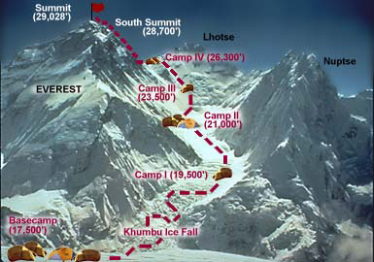
Summit | SMART on FHIR Explicit Std Profiles | Plug and Play Shareable apps
SMART on FHIR
Explicit Std Profiles
SMART on FHIR
Ad Hoc Profiles
Camp IV | SMART on FHIR Ad Hoc Profiles | Core Resources
Camp III | HL7 V2.X, CDA LOINC, SNOMED | Still need DCMs Mapping of Std Terms
HL7 V2.X, CDA
LOINC, SNOMED
Camp II | HL7 V2.X | Need DCMs and Terminology
HL7 V2.X
No standards
Camp I | No standards | Everything from scratch

Slide 41
More about where we are today
41

Slide 42
What is HL7 FHIR©®?
A set of modular components called “Resources”
Resources refer to each other using URLs
Build a web to support healthcare process
Exchange resources between systems
Using a RESTful API (e.g. web approach)
As a bundle of resources (messages, documents)

Slide 43

FHIR: Core Resources
AdverseReaction
Alert
AllergyIntolerance
CarePlan
Composition
ConceptMap
Condition
Conformance
Device
DeviceObservationReport
DiagnosticOrder
DiagnosticReport
DocumentReference
DocumentManifest
Encounter
FamilyHistory
Group
ImagingStudy
Immunization
ImmunizationRecommendation
List
Location
Media
Medication
MedicationAdministration
MedicationDispense
MedicationPrescription
MedicationStatement
MessageHeader
Observation
OperationOutcome
Order
OrderResponse
Organization
Other
Patient
Practitioner
Procedure
Profile
Provenance
Query
Questionnaire
RelatedPerson
SecurityEvent
Specimen
Substance
Supply
ValueSet

Slide 44
Observation Resource
Observation (DomainResource)
identifier : Identifier [0..*]status : code [1..1]« ObservationStatus! »
code : CodeableConcept [1..1] « LOINC ?? »
subject : Reference [0..1]« Patient|Group|Device|Location »
encounter : Reference [0..1] « Encounter »
effective[x] : Type [0..1]« dateTime|Period »
value[x] : Type [0..1]
« Quantity|CodeableConcept|string|Range|Ratio|SampledData|
Attachment|time|dateTime|Period »
interpretation : CodeableConcept [0..1] « Observation Interpretation+ »
method : CodeableConcept [0..1] « Observation Methods?? »
specimen : Reference [0..1] « Specimen »
device : Reference [0..1] « Device|DeviceMetric »

Slide 45
Profile for “Blood pressure”
Observation = Blood Pressure
Subject.reference: Patient URL
Coding: LOINC 55284-4
Related:
type: has-component
target.reference:
Observation URL
type: has-component
target.reference:
Observation URL
Observation = Systolic BP
name: “Systolic”
coding: LOINC 8480-6
value.units: “mmHg”
Observation = Diastolic BP
name: “Diastolic”
coding: LOINC 8462-4
value.units: “mmHg”

Slide 46
What if we use different models?
Site #1
70
Dry Weight:
70
kg
Site #2
70
Dry
Weight:
70
kg
Wet
Ideal

Slide 47
Too many ways to say the same thing
A single name/code and value
Dry Weight is 70 kg
Combination of two names/codes and values
Weight is 70 kg
Weight type is dry

Slide 48
Implications of different models
Patient Identifier
Date and Time
Observation Type
Observation Value
Units
123456789
7/4/2005
Dry Weight
70
kg
123456789
7/19/2005
Current Weight
73
kg
Patient Identifier
Date and Time
Observation Type
Weight type
Observation Value
Units
123456789
7/4/2005
Weight
Dry
70
kg
123456789
7/19/2005
Weight
Current
73
kg
How would you calculate the desired weight loss during the hospital stay?

Slide 49
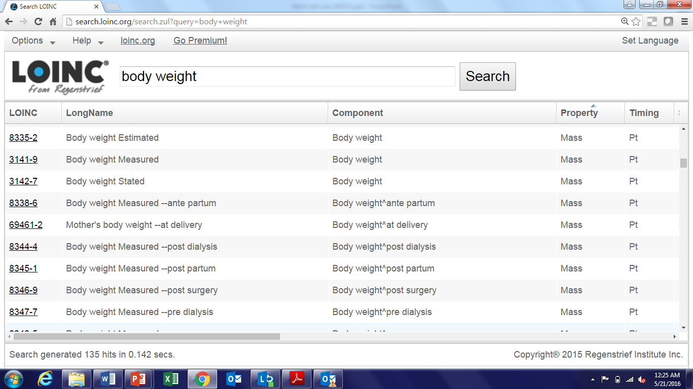
LOINC Codes for Weight

Slide 50
CIMI
The Clinical Information Modeling Initiative (CIMI) is an HL7 Work Group that is producing detailed clinical information models to enable interoperability of health care information systems
CIMI was initiated during a “Fresh Look” session at an HL7 meeting in 2011
CIMI models are free for use for all purposes
See http://www.opencimi.org/ for more details

Slide 51
CIMI Goals
Create a shared repository of detailed clinical information models
Repository is open to everyone and models are licensed free for use at no cost
Where the models:
Are expressed in an approved formalism
Archetype Definition Language (ADL)
Archetype Modeling Language (AML)
Are based on a core reference model, including a set of base data types
Have formal bindings to standard coded terminologies

Slide 52
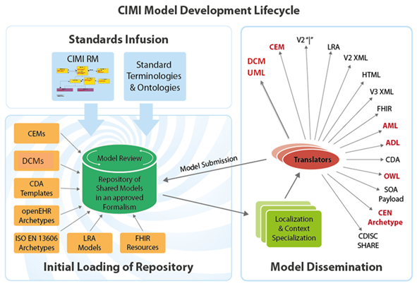

Slide 53
The danger
No true interoperability because
Vendors use different models/profiles
Government agencies use different models/profiles
Provider organizations use different models/profiles
Professional organizations use different models/profiles

Slide 54
What is needed to get to the summit?

Slide 55
What is needed?
Use the SMART on FHIR strategy
A common open set of models/profiles
Available at no cost
That we all agree to use for the purpose of interoperability

Slide 56
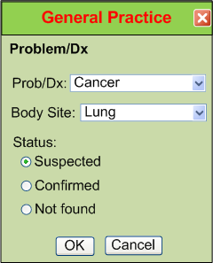
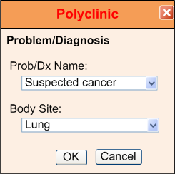
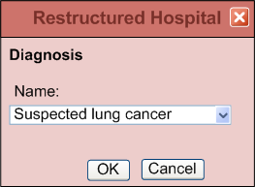
IsoSemantic Models – Example of Problem
(from Dr. Linda Bird)
e.g. “Suspected Lung Cancer”
55

Slide 57
Data Comes in Different Shapes and Colors
Finding – Suspected Lung Cancer
Finding – Suspected Cancer
Location – Lung
Finding – Cancer
Location – Lung
Certainty – Suspected
(Let’s say this is the preferred shape)
56

Slide 58

Data Standardized in the Service
Application
Application
and User
Data in preferred shape and color
Shape and color translation
Shape and color of data
in the local database
57

Slide 59
Partial Interoperability
Application
Application
and User
Standard Terms
(Non-standard Structure)
Term
Translators
Local databases,
CDA, HL7 V.2, etc.
58

Slide 60
Preferred Strategy – Full Interoperability
Application
Application
and User
Standard Structure
AND Standard Terms
(As defined by CIMI Models)
Requirements
Term and
Structure
Translators
Local databases,
CDA, HL7 V.2, etc.
59

Slide 61
Reasons to do it on the server side
Person writing the translation is most likely to understand the meaning of the data in their own database.
The person writing the translation only has to understand their own data and the preferred model.
They can optimize query execution for their own system
The query for the data is simpler. If the application has to write a query that will work for all shapes, the query will be inefficient to process by every system.
60

